Slide 1
DATA SCIENCE Class 1: Intro to Data Science
Notes:
~15-20 min on initial stuff
Note: example DS problem…write down some features, how could you build a predictive model from these?

Slide 2
0. who Is A Data Scientist? I. How Data Scientists Add Value II. the Data Mining Workflow III. Qualities of a good Data Scientist
AGENDA
Notes:
All of our classes will involve some hands-on work (in the exercises section)

Slide 3
0. who is A Data Scientist?
INTRO TO DATA SCIENCE
Notes:
~15-20 min for this section?

Slide 4
What Is your definition?
WHAT IS A DATA SCIENTIST?
Notes:
~15-20 min for this section?

Slide 5
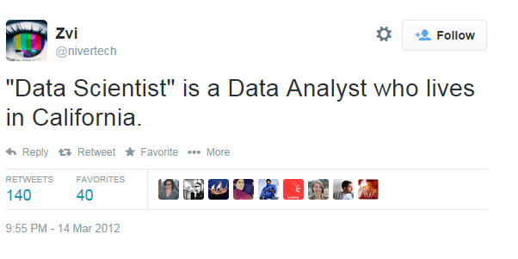
WHAT IS A DATA SCIENTIST?
Notes:
~15-20 min for this section?

Slide 6
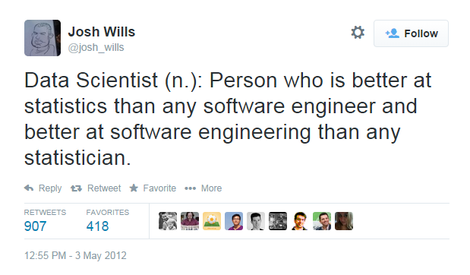
WHAT IS A DATA SCIENTIST?
Notes:
~15-20 min for this section?

Slide 7
WHAT IS A DATA SCIENTIST?
Data Scientists solve
complex problems
using data mining techniques
Problem
Domain
Computer Science
Statistics
Notes:
~15-20 min for this section?

Slide 8
WHAT IS A DATA SCIENTIST?
Wide variance in terms of skillsets: many job descriptions are more appropriate for a team of data scientists
Data Scientists solve
complex problems
using data mining techniques
Problem
Domain
Computer Science
Statistics
Notes:
~15-20 min for this section?

Slide 9
I. How Data Scientists Add Value
INTRO TO DATA SCIENCE
Notes:
~15-20 min for this section?

Slide 10
HOW DATA SCIENTISTS ADD VALUE
5 Minutes:
Take 5 minutes, search the internet, and write down as many examples as you can of data scientists in action.
5 Minutes:
In a small group, introduce yourselves. As a group, decide how to best “cluster” your examples around how the data scientist adds value. You can have as many clusters as you want! Make sure you have a label for each cluster.
Notes:
Lots of names you’d expect (also obama, nyt → politics = growth area)
Q: can you think of any others? → show some example in the browser
Soon the question will be: who doesn’t use data science?

Slide 11
HOW DATA SCIENTISTS ADD VALUE
Data mining techniques generally add value by doing one of four things:
Predicting the bad
Identifying the good
Automating existing processes
Identifying patterns in data
Data scientists can be found within many fields: let’s look at some additional examples to motivate this course.
Source: https://www.youtube.com/watch?v=fPzmnRj671Y
Notes:
Lots of names you’d expect (also obama, nyt → politics = growth area)
Q: can you think of any others? → show some example in the browser
Soon the question will be: who doesn’t use data science?

Slide 12
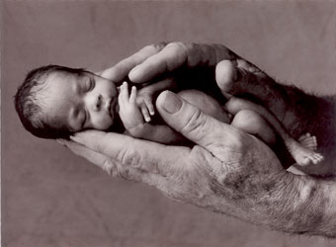
Example #1: Predicting Neonatal Infection
Problem: Children born prematurely are at high risk of developing infections, many of which are not detected until after the baby is sick
Goal: Detect subtle patterns in the data that predicts infection before it occurs
Data: 16 vital signs such as heart rate, respiration rate, blood pressure, etc…
Impact: Model is able to predict the onset of infection 24 hours before the traditional symptoms of infection appear
Image: http://www.babycaretips4u.com/wp-content/uploads/2014/03/premature-baby.jpg
Case Study: http://www.amazon.com/Big-Data-Revolution-Transform-Think/dp/0544002695
Notes:
Lots of names you’d expect (also obama, nyt → politics = growth area)
Q: can you think of any others? → show some example in the browser
Soon the question will be: who doesn’t use data science?

Slide 13

Example #2: Automating Government Paper-Pushing
Problem: Processing disability claims at the Social Security Administration is a time-intensive process, with many claims taking over 2 years to adjudicate
Goal: Automate the approval of a subset of the “simplest” disability claims
Data: Free text in the claims form
Impact: Able to fully automate 20% of the simplest claims. Rating accuracy of the algorithm is higher than the average claims examiner.
Case Study: http://datamininglab.com/images/case-studies/ERI_Text_Mining_SSA_Claims_for_Disability_Approval.pdf
Notes:
Lots of names you’d expect (also obama, nyt → politics = growth area)
Q: can you think of any others? → show some example in the browser
Soon the question will be: who doesn’t use data science?

Slide 14
Ii. the data Mining workflow
INTRO TO DATA SCIENCE
Notes:
~15-20 min for this section?
So what does data science look like?

Slide 15
The data MINING WORKFLOW
0. Define the problem / question
I. Identify and collect data
II. Explore and prepare data
III. Build and evaluate model
IV. Communicate results
Notes:
Lots of names you’d expect (also obama, nyt → politics = growth area)
Q: can you think of any others? → show some example in the browser
Soon the question will be: who doesn’t use data science?

Slide 16
0. Define the Problem / Question
THE DATA MINING WORKFLOW
Can I predict infection before it occurs?
Can I predict claim approval from the start of the process?
Notes:
~15-20 min for this section?

Slide 17
I. IDENTIFY AND COLLECT DATA
THE DATA MINING WORKFLOW
Vital Areas: Heart Rate, Blood Pressure, etc…
Want to collect all data on the claim form (mostly free text)
Notes:
~15-20 min for this section?

Slide 18
II. EXPLORE AND PREPARE DATA
THE DATA MINING WORKFLOW
Aggregate data at the minute level
Cluster like words
Notes:
~15-20 min for this section?

Slide 19
III. BUILD AND EVALUATE Models
THE DATA MINING WORKFLOW
Compare Decision Tree with Logistic Regression
Start with Naïve Bayes Classifier
Notes:
~15-20 min for this section?

Slide 20
IV. COMMUNICATE RESULTS
THE DATA MINING WORKFLOW
Create custom dashboard for doctors and nurses
Create report and dashboard proof of concept
Notes:
~15-20 min for this section?

Slide 21
III. Qualities of a good data scientist
INTRO TO DATA SCIENCE
Notes:
~15-20 min for this section?

Slide 22
Asks Rational Questions
Qualities of a good data scientist
Notes:
~15-20 min for this section?

Slide 23
Retains Intellectual Humility
Qualities of a good data scientist
Notes:
~15-20 min for this section?

Slide 24
Communicates Clearly
Qualities of a good data scientist
Notes:
~15-20 min for this section?

Slide 25
Understands the pros & cons of different techniques
Qualities of a good data scientist
Notes:
~15-20 min for this section?

Slide 26
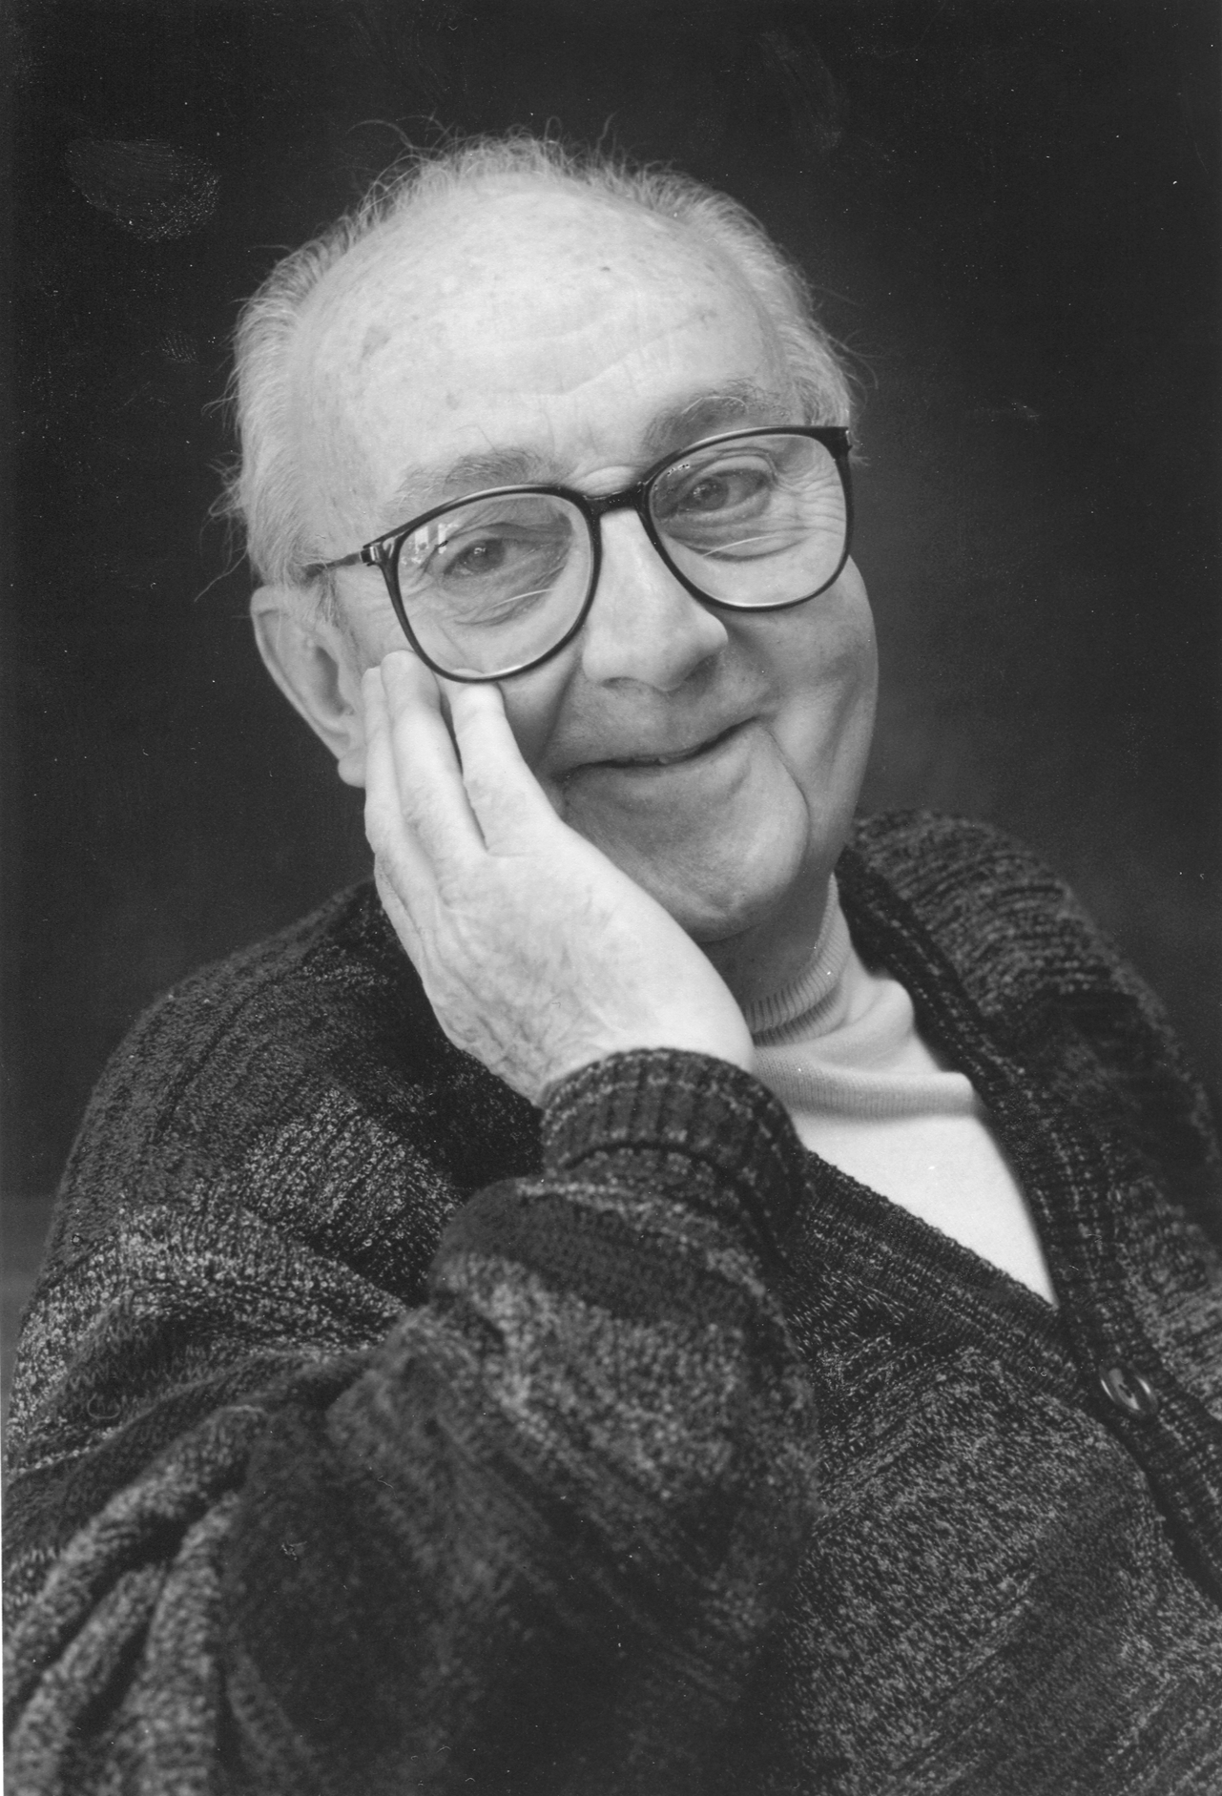
STATISTICIANS, LIKE ARTISTS, have the bad habit of falling in love with their models - George Box
Qualities of a good data scientist
Notes:
~15-20 min for this section?

